Slide 1
Network Theorems

Slide 2
Superposition Theorem
  The superposition theorem extends the use of Ohm’s Law to circuits with multiple sources.
  In order to apply the superposition theorem to a network, certain conditions must be met:
    All the components must be linear, meaning that the current is proportional to the applied voltage.

Slide 3
Superposition Theorem
    All the components must be bilateral, meaning that the current is the same amount for opposite polarities of the source voltage.
    Passive components may be used. These are components such as resistors, capacitors, and inductors, that do not amplify or rectify.
    Active components may not be used. Active components include transistors, semiconductor diodes, and electron tubes. Such components are never bilateral and seldom linear.

Slide 4
Superposition Theorem
  In a linear, bilateral network that has more than one source, the current or voltage in any part of the network can be found by adding algebraically the effect of each source separately.
  This analysis is done by:
    shorting each voltage source in turn.
    opening each current source in turn.

Slide 5
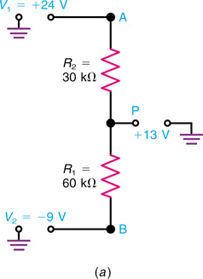
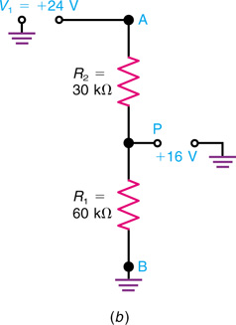
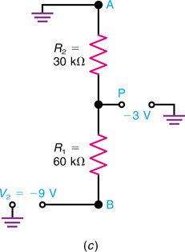
Superposition Theorem
Superposition theorem applied to a voltage divider with two sources V₁ and V₂. (a) Actual circuit with +13 V from point P to chassis ground. (b) V₁ alone producing +16 V at P. (c) V₂ alone producing −3 V at P.

Slide 6
Superposition Theorem
R₁
R₂
15 V
100 Ω
20 Ω
13 V
V₁
10 Ω
R₃
V₂
R₁
R₂
15 V
100 Ω
20 Ω
V₂ shorted
V₁
10 Ω
R₃
R_{EQ} = 106.7 Ω, I_{T} = 0.141 A and I_{R3} = 0.094 A

Slide 7
Superposition Theorem (Applied)
R₁
R₂
15 V
100 Ω
20 Ω
13 V
V₁
10 Ω
R₃
V₂
R₁
R₂
100 Ω
20 Ω
13 V
V₁ shorted
V₂
10 Ω
R₃
R_{EQ} = 29.09 Ω, I_{T} = 0.447 A and I_{R3} = 0.406 A

Slide 8
Superposition Theorem (Applied)
R₁
R₂
15 V
100 Ω
20 Ω
13 V
V₁
V₂
0.094 A
0.406 A
With V₂ shorted
R_{EQ} = 106.7 Ω, I_{T} = 0.141 A and I_{R3} = 0.094 A
With V₁ shorted
R_{EQ} = 29.09 Ω, I_{T} = 0.447 A and I_{R3} = 0.406 A
Adding the currents gives I_{R3} = 0.5 A

Slide 9
Superposition Method (Check)
R₁
R₂
15 V
100 Ω
20 Ω
13 V
V₁
10 Ω
R₃
V₂
0.5 A
With 0.5 A flowing in R₃, the voltage across R₃ must
be 5 V (Ohm’s Law). The voltage across R₁ must
therefore be 10 volts (KVL) and the voltage across R₂
must be 8 volts (KVL). Solving for the currents in R₁
and R₂ will verify that the solution agrees with KCL.
I_{R1} = 0.1 A and I_{R2} = 0.4 A
I_{R3} = 0.1 A + 0.4 A = 0.5 A

Slide 10
Thevenin’s Theorem
  Thevenin’s theorem simplifies the process of solving for the unknown values of voltage and current in a network by reducing the network to an equivalent series circuit connected to any pair of network terminals.
  Any network with two open terminals can be replaced by a single voltage source (V_{TH}) and a series resistance (R_{TH}) connected to the open terminals. A component can be removed to produce the open terminals.

Slide 11
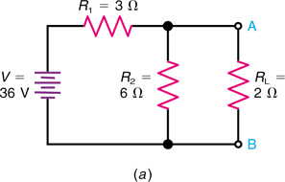
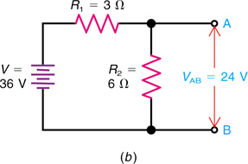
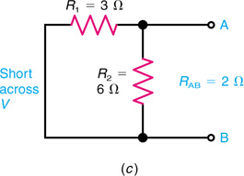
Thevenin’s Theorem
Application of Thevenin’s theorem. (a) Actual circuit with terminals A and B across R_{L}. (b) Disconnect R_{L} to find that V_{AB} is 24V. (c) Short-circuit V to find that R_{AB} is 2Ω.

Slide 12
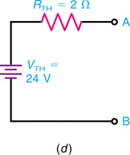
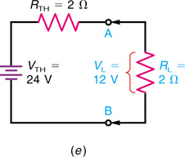
Thevenin’s Theorem
(d) Thevenin equivalent circuit. (e) Reconnect R_{L} at terminals A and B to find that V_{L} is 12V.

Slide 13
Thevenin’s Theorem
Determining Thevenin Resistance and Voltage
  R_{TH} is determined by shorting the voltage source and calculating the circuit’s total resistance as seen from open terminals A and B.
  V_{TH} is determined by calculating the voltage between open terminals A and B.

Slide 14
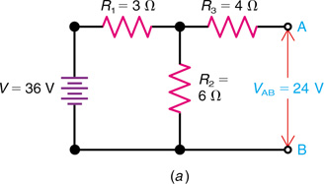
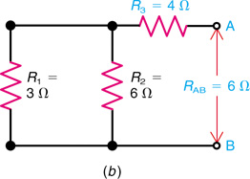
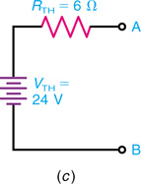
Thevenin’s Theorem
Note that R₃ does not change the value of V_{AB} produced by the source V, but R₃ does increase the value of R_{TH}.
Thevenizing the circuit of Fig. 10-3 but with a 4-Ω R₃ in series with the A terminal. (a) V_{AB} is still 24V. (b) Now the R_{AB} is 2 + 4 = 6 Ω. (c) Thevenin equivalent circuit.

Slide 15
Thevenizing a Circuit
with Two Voltage Sources
The circuit in Figure 10-5 can b solved by Kirchhoff’s laws, but Thevenin’s theorem can be used to find the current I₃ through the middle resistance R₃.
  Mark the terminals A and B across R₃.
  Disconnect R₃.
  To calculate V_{TH}, find V_{AB} across the open terminals

Slide 16
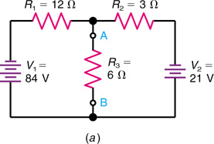
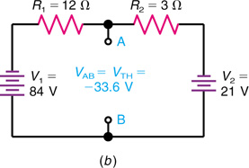
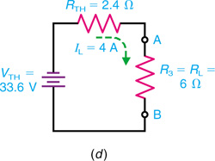
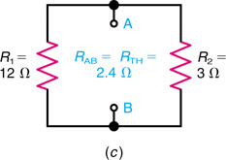
Thevenizing a Circuit
with Two Voltage Sources
Thevenizing a circuit with two voltage sources V₁ and V₂. (a) Original circuit with terminals A and B across the middle resistor R₃. (b) Disconnect R₃ to find that V_{AB} is −33.6V. (c) Short-circuit V₁ and V₂ to find that R_{AB} is 2.4 Ω. (d) Thevenin equivalent with R_{L} reconnected to terminals A and B.

Slide 17
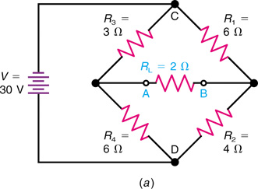
Thevenizing a Bridge Circuit
A Wheatstone Bridge Can Be Thevenized.
    Problem: Find the voltage drop across R_{L}.
    The bridge is unbalanced and Thevenin’s theorem is a good choice.
    R_{L} will be removed in this procedure making A and B the Thevenin terminals.
Thevenizing a bridge circuit. (a) Original circuit with terminals A and B across middle resistor R_{L}.

Slide 18
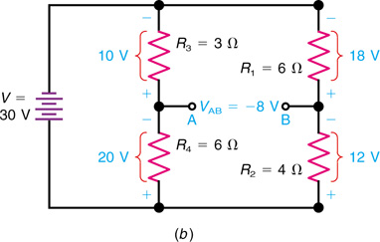
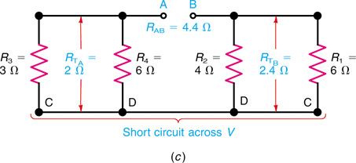
Thevenizing a Bridge Circuit
R_{AB} = R_{TA} + R_{TB} = 2 + 2.4 = 4.4 Ω
V_{AB} = −20 −(−12) = −8V
(b) Disconnect R_{L} to find V_{AB} of −8 V. (c) With source V short-circuited, R_{AB} is 2 + 2.4 = 4.4 Ω.

Slide 19
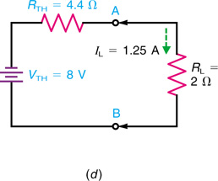
Thevenizing a Bridge Circuit
(d) Thevenin equivalent with R_{L} reconnected to terminals A and B.

Slide 20
Thevenizing a Bridge Circuit
(d) Thevenin equivalent with R_{L} reconnected to terminals A and B.

Slide 21
Norton’s Theorem
  Norton’s theorem is used to simplify a network in terms of currents instead of voltages.
  It reduces a network to a simple parallel circuit with a current source (comparable to a voltage source).
  Norton’s theorem states that any network with two terminals can be replaced by a single current source and parallel resistance connected across the terminals.
    The two terminals are usually labeled something such as A and B.
    The Norton current is usually labeled I_{N.}
    The Norton resistance is usually labeled R_{N.}

Slide 22
Norton’s Theorem
Example of a Current Source
  The symbol for a current source is a circle enclosing an arrow that indicates the direction of current flow. The direction must be the same as the current produced by the polarity of the corresponding voltage source (which produces electron flow from the negative terminal).

Slide 23
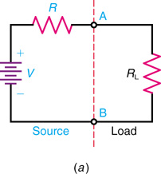
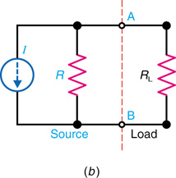
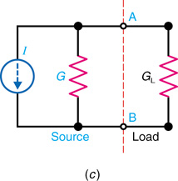
Norton’s Theorem
General forms for a voltage source or current source connected to a load R_{L} across terminals A and B. (a) Voltage source V with series R. (b) Current source I with parallel R. (c) Current source I with parallel conductance G.

Slide 24
Norton’s Theorem
Example of a Current Source
  In this example, the current I is provided constant with its rating regardless of what may be connected across output terminals A and B. As resistances are added, the current divides according to the rules for parallel branches (inversely to branch resistances but directly with conductances).
  Note that unlike voltage sources, current sources are killed by making them open.

Slide 25
Norton’s Theorem
Determining Norton Current and Voltage
  I_{N} is determined by calculating the current through a short placed across terminals A and B.
  R_{N} is determined by shorting the voltage source and calculating the circuit’s total resistance as seen from open terminals A and B (same procedure as for R_{TH}).

Slide 26
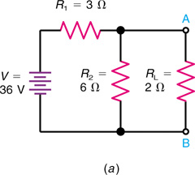
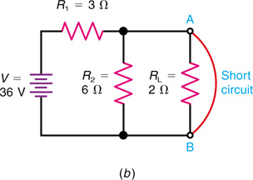
Norton’s Theorem
A Wheatstone Bridge Can Be Nortonized.
(a) Original circuit. (b) Short circuit across terminals A and B.

Slide 27
Norton’s Theorem
The Norton Equivalent Circuit
  Replace R₂ with a short and determine I_{N}.
  Apply the current divider.
  Apply KCL.
  R_{N} = R_{TH}.
  The current source provides 12 A total flow, regardless of what is connected across it. With no load, all of the current will flow in R_{N}. When shorted, all of the current will flow in the short.
    Connect R₂.
    Apply the current divider.
    Use Ohm’s Law.

Slide 28
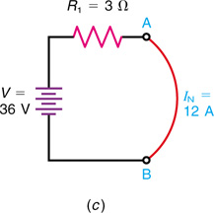
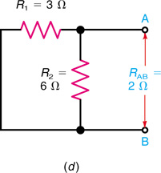
Norton’s Theorem
(c) The short-circuit current I_{N} is 36/3 = 12 A. (d) Open terminals A and B but short-circuit V to find R_{AB} is 2 Ω, the same as R_{TH}.

Slide 29
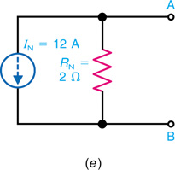
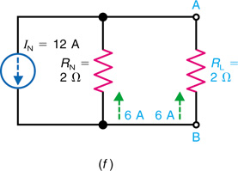
Norton’s Theorem
I_{L} = I_{N} x R_{N}/R_{N} + R_{L} = 12 x 2/4 = 6 A
(e) Norton equivalent circuit. (f) R_{L} reconnected to terminals A and B to find that I_{L} is 6A.

Slide 30
Thevenin-Norton Conversions
Thevenin’s theorem says that any network can be represented by a voltage source and series resistance.
Norton’s theorem says that the same network can be represented by a current source and shunt resistance.
Therefore, it is possible to convert directly from a Thevenin form to a Norton form and vice versa.
Thevenin-Norton conversions are often useful.

Slide 31
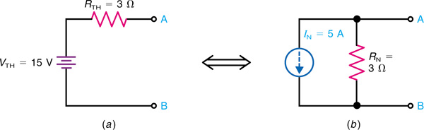
Thevenin-Norton Conversions
Thevenin
Norton
Thevenin equivalent circuit in (a) corresponds to the Norton equivalent in (b).

Slide 32
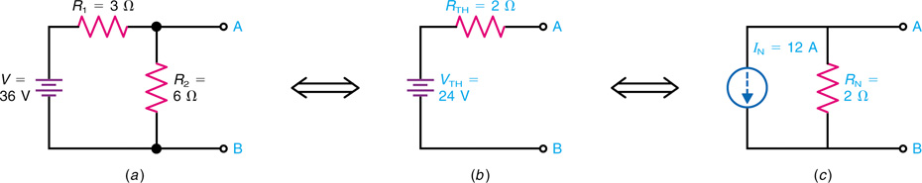
Thevenin-Norton Conversions
Example of Thevenin-Norton conversions. (a) Original circuit (b) Thevenin equivalent. (c) Norton equivalent.

Slide 33
Conversion of Voltage
and Current Sources
  Converting voltage and current sources can simplify circuits, especially those with multiple sources.
  Current sources are easier for parallel connections, where currents can be added or divided.
  Voltage sources are easier for series connections, where voltages can be added or divided.

Slide 34
Conversion of Voltage
and Current Sources
Norton conversion is a specific example of the general principle that any voltage source with its series resistance can be converted to an equivalent current source with the same resistance in parallel.
Conversion of voltage and current sources can often simplify circuits, especially those with two or more sources.
Current sources are easier for parallel connections, where currents can be added or divided.
Voltage sources are easier for series connections, where voltages can be added or divided.

Slide 35
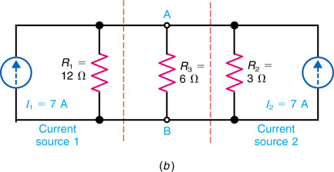
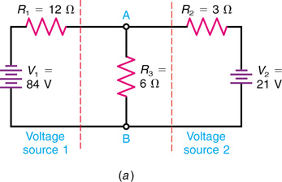
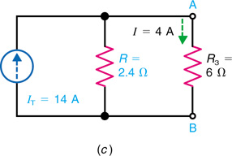
Conversion of Voltage
and Current Sources
Converting two voltage sources in V₁ and V₂ in parallel branches to current sources I₁ and I₂ that can be combined. (a) Original circuit. (b) V₁ and V₂ converted to parallel current sources I₁ and I₂. (c) Equivalent circuit with one combined current source I_{T}.

Slide 36
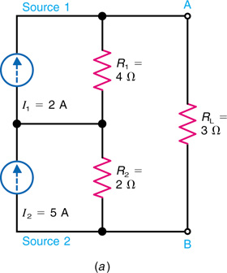
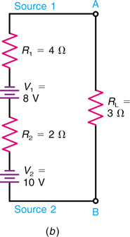
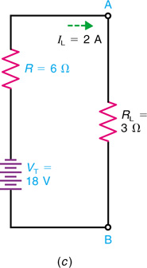
Conversion of Voltage
and Current Sources

Slide 37
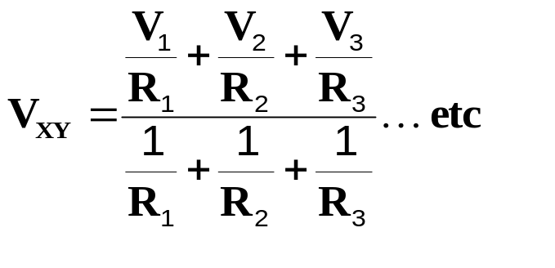
Millman’s Theorem
  Millman’s theorem provides a shortcut for finding the common voltage across any number of parallel branches with different voltage sources.
  The theorem states that the common voltage across parallel branches with different voltage sources can be determined by:
  This formula converts the voltage sources to current sources and combines the results.

Slide 38
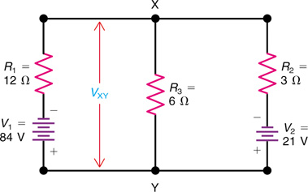
Millman’s Theorem
shown with parallel branches to calculate V_{XY} by Millman’s theorem.

Slide 39
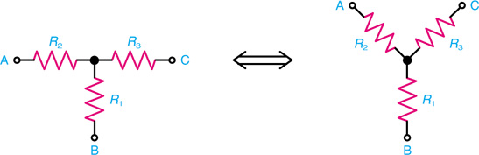
T or Y and π or Δ Conversions
  Circuits are sometimes called different names according to their shapes.
  This circuit is the same circuit in both diagrams. The one on the left is a T (tee) network; the one on the right is a Y (wye) network.
The form of a T or Y network.

Slide 40
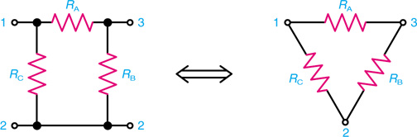
T or Y and π or Δ Conversions
  Both of the following networks are the same; the one on the left is called a pi (π), and the one on the right is called a delta (Δ), because the forms resemble those Greek characters.
The form of a π or Δ network.

Slide 41
T or Y and π or Δ Conversions
  The Y and Δ forms are different ways to connect three resistors in a passive network.
  When analyzing such networks, it is often useful to convert a Δ to a Y or vice-versa.

Slide 42
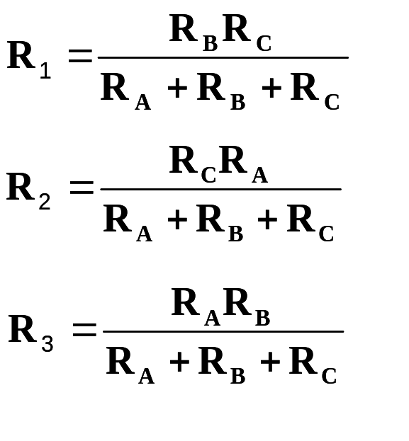
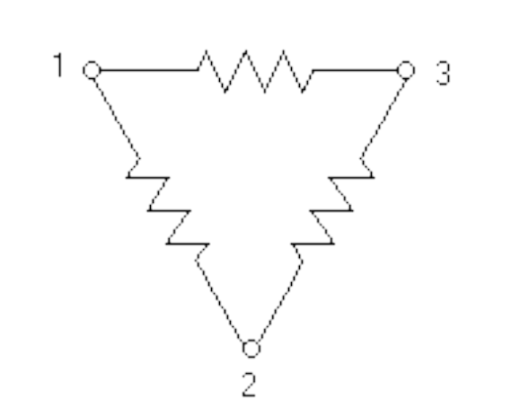
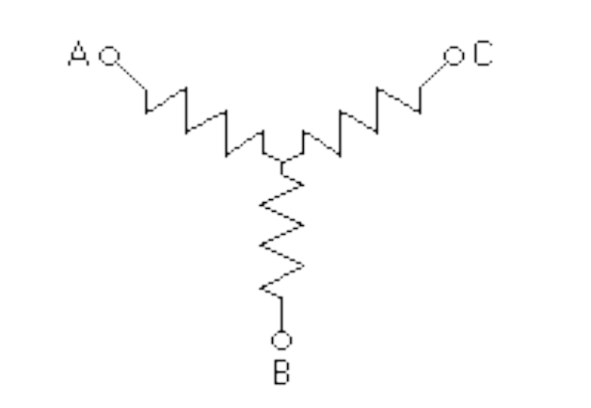
T or Y and π or Δ Conversions
Delta-to-Wye Conversion
  A delta (Δ) circuit can be converted to a wye (Y) equivalent circuit by applying Kirchhoff’s laws:
  This approach also converts a T to a π network.
R_{A}
R₂
R₃
R_{C}
R_{B}
R₁

Slide 43
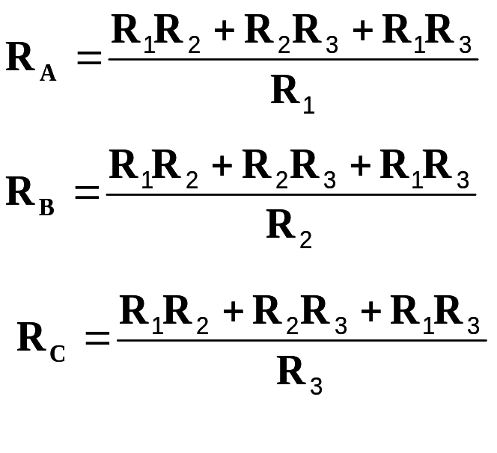
T or Y and π or Δ Conversions
Wye-to-delta Conversion
  A wye (Y) circuit can be converted to a delta (Δ) equivalent circuit by applying Kirchhoff’s laws:
R_{A}
R₂
R₃
R_{C}
R_{B}
R₁

Slide 44
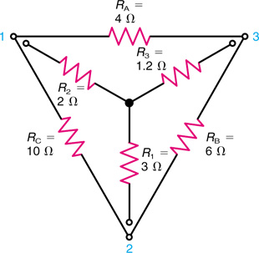
T or Y and π or Δ Conversions
Useful aid in using formulas:
Place the Y inside the Δ.
Note the Δ has three closed sides and the Y has three open arms.
Note how resistors can be considered opposite each other in the two networks.
Each resistor in an open arm has two adjacent resistors in the closed sides.
Conversion between Y and Δ networks.

Slide 45
T or Y and π or Δ Conversions
In the formulas for the Y-to-Δ conversion, each side of the delta is found by first taking all possible cross products of the arms of the wye, using two arms at a time. (There are three such cross products.)
The sum of the three cross products is then divided by the opposite arm to find the value of each side of the delta.
Note that the numerator remains the same, the sum of the three cross products.
Each side of the delta is calculated by dividing this sum by the opposite arm.

Slide 46
T or Y and π or Δ Conversions
For the Δ-to-Y conversion, each arm of the wye is found by taking the product of the two adjacent sides in the delta and dividing by the sum of the three sides of the delta.
The product of the two adjacent resistors excludes the opposite resistor.
The denominator for the sum of the three sides remains the same in the three formulas.
Each arm is calculated by dividing the sum into each cross product.

Slide 47
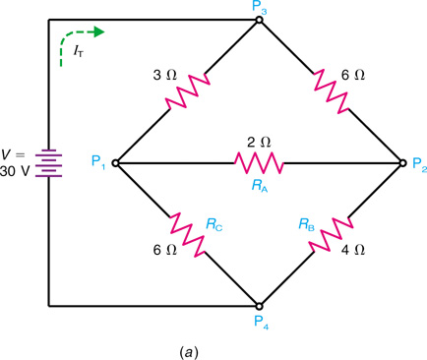
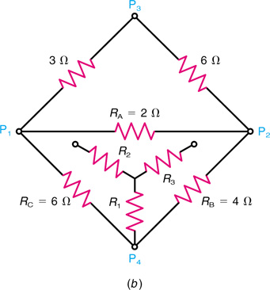
T or Y and π or Δ Conversions
A Wheatstone Bridge Can Be Simplified.
The total current I_{T} from the battery is desired. Therefore, total resistance R_{T} must be found.
Solving a bridge circuit by Δ-to-Y conversion. (a) Original circuit. (b) How the Y of R₁R₂R₃ corresponds to the Δ of R_{A}R_{B}R_{C}.

Slide 48
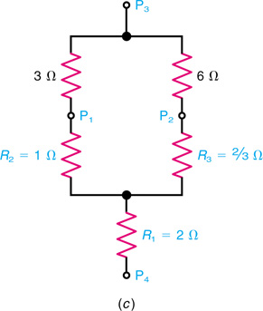
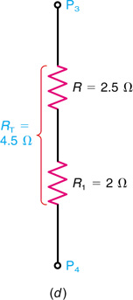
T or Y and π or Δ Conversions
R_{T} = R + R₁ = 2.5 + 2 = 4.5 Ω
(c) The Y substituted for the Δ network. The result is a series-parallel circuit with the same R_{T} as the original bridge circuit. (d) R_{T} is 4.5Ω between points P₃ and P₄.

